Slide 1

02
Background
RDMA Write Flow (Send Side)
NCCL
Plugin
Libfabric
EFA
Sender
o
$$G×S$$
ctrl_msg (rx)
Receiver
isend()
o
fi_writedata()
L
RDMA write
fi_cq_read()
CQE
test()
4/59

Slide 2
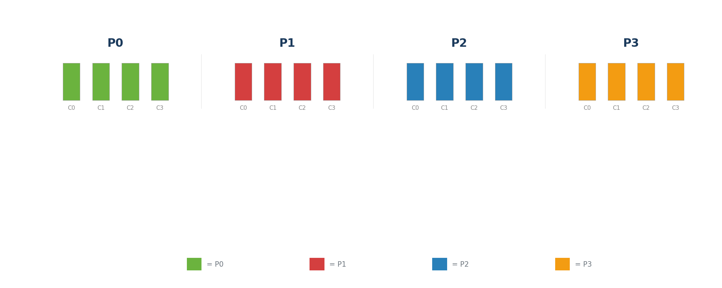
05
Ring AllReduce (How NCCL Behaves) — Multi-Chunk
Initial: each GPU has 4 chunks of its own data
Dashed = OUT Thick = IN Arcs = transfer Stripes = sources
13/59

Slide 3
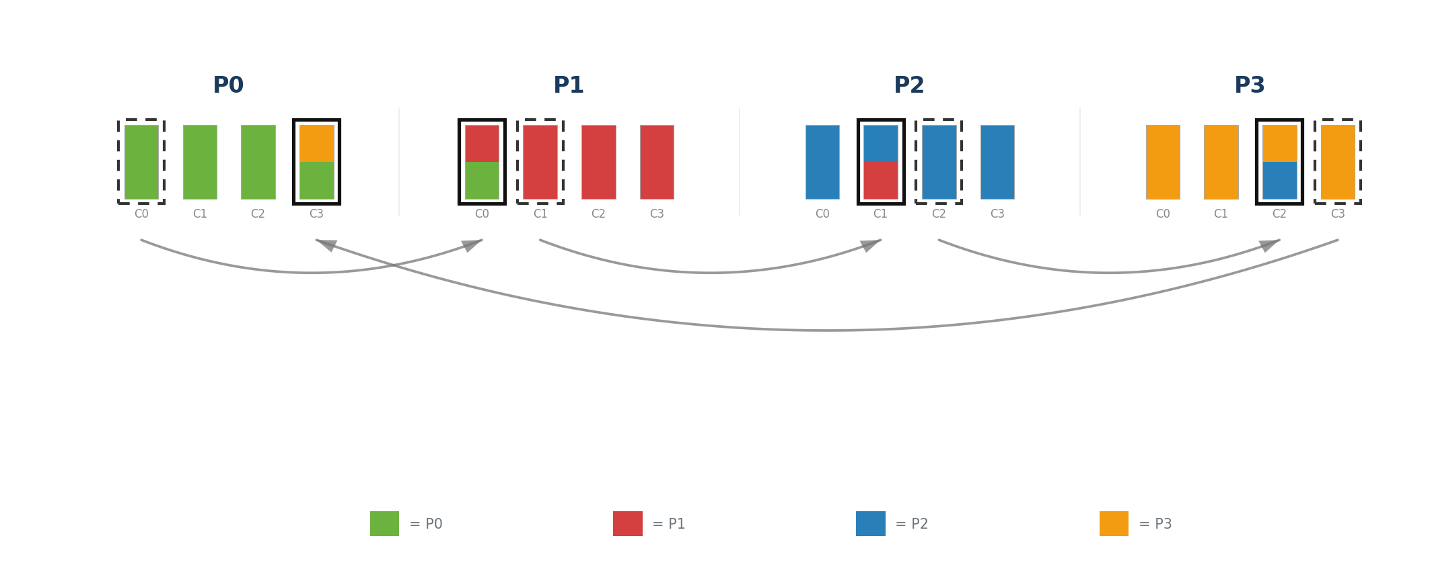
05
Ring AllReduce (How NCCL Behaves) — Multi-Chunk
RS Step 1: each GPU sends a different chunk →
T = α + β × S/N (S: Message Size, N = Number of GPUs)
ReduceScatter: N−1 steps
Dashed = OUT Thick = IN Arcs = transfer Stripes = sources
14/59

Slide 4
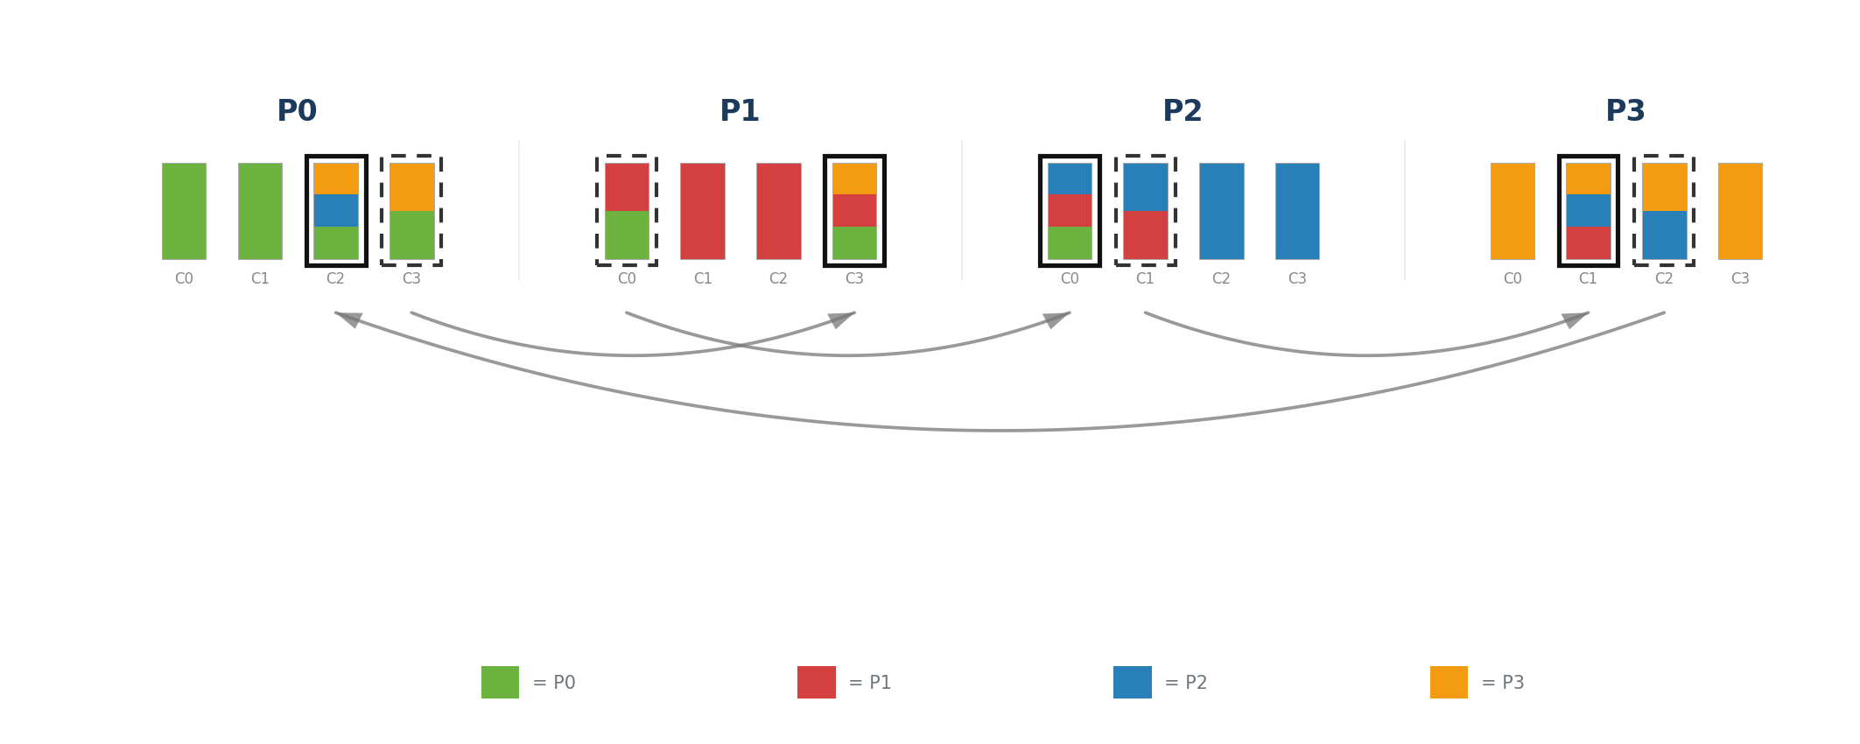
05
Ring AllReduce (How NCCL Behaves) — Multi-Chunk
RS Step 2: send the accumulated chunk onward →
T = α + β × S/N (S: Message Size, N = Number of GPUs)
ReduceScatter: N−1 steps
Dashed = OUT Thick = IN Arcs = transfer Stripes = sources
15/59

Slide 5
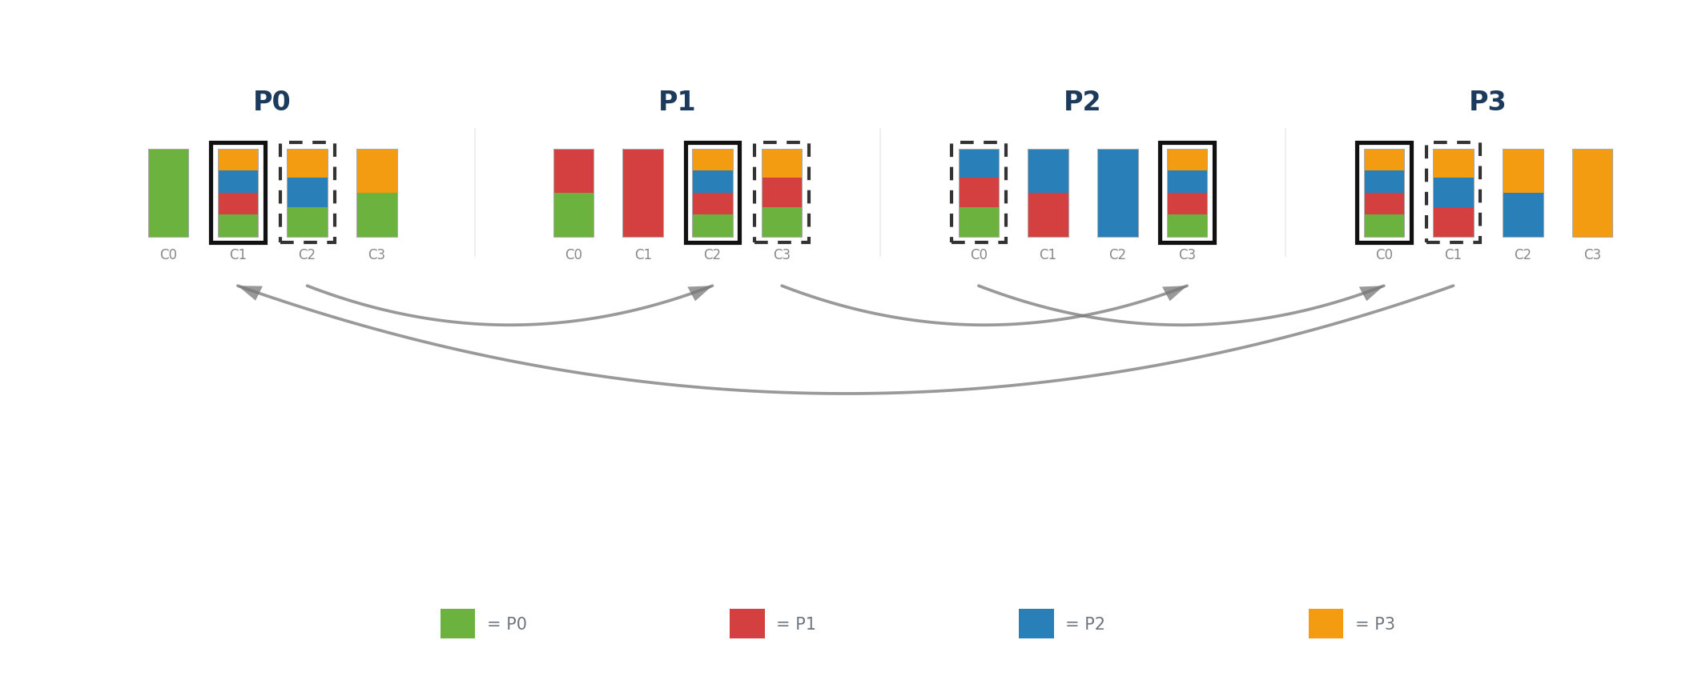
05
Ring AllReduce (How NCCL Behaves) — Multi-Chunk
RS Step 3: one chunk per GPU fully reduced
T = α + β × S/N (S: Message Size, N = Number of GPUs)
ReduceScatter: N−1 steps
Dashed = OUT Thick = IN Arcs = transfer Stripes = sources
16/59

Slide 6
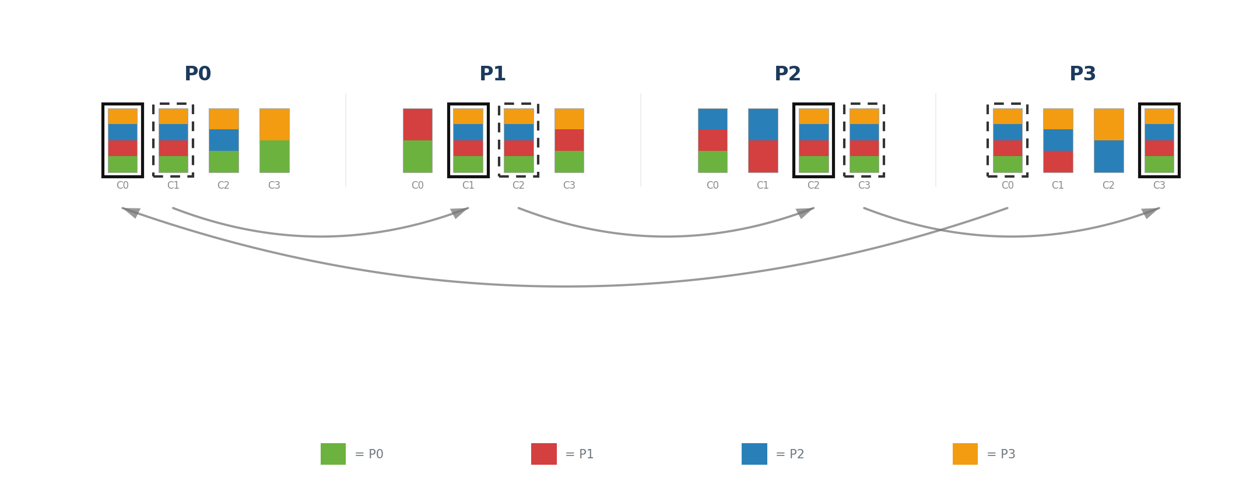
05
Ring AllReduce (How NCCL Behaves) — Multi-Chunk
AG Step 4: broadcast fully reduced chunk →
T = α + β × S/N (S: Message Size, N = Number of GPUs)
AllGather: N−1 steps
Dashed = OUT Thick = IN Arcs = transfer Stripes = sources
17/59

Slide 7
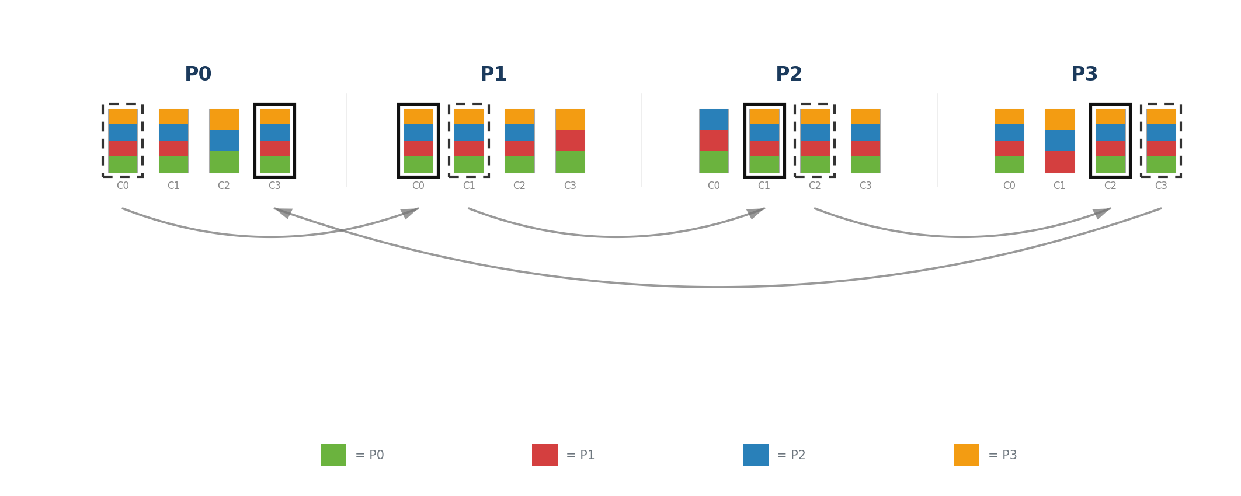
05
Ring AllReduce (How NCCL Behaves) — Multi-Chunk
AG Step 5: continue broadcasting →
T = α + β × S/N (S: Message Size, N = Number of GPUs)
AllGather: N−1 steps
Dashed = OUT Thick = IN Arcs = transfer Stripes = sources
18/59

Slide 8
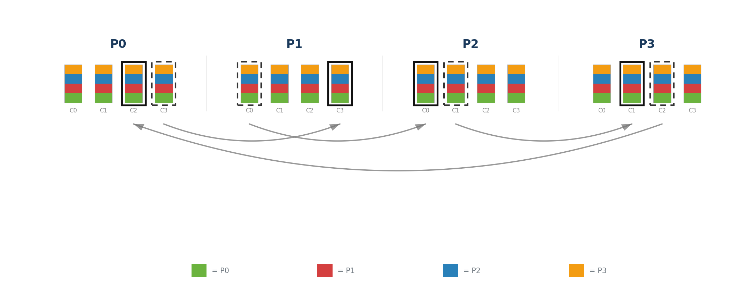
05
Ring AllReduce (How NCCL Behaves) — Multi-Chunk
AG Step 6: all GPUs have all chunks fully reduced
T = α + β × S/N (S: Message Size, N = Number of GPUs)
ReduceScatter (N−1) + AllGather (N−1) = 2(N−1) total steps
Total time: T = 2 × (N−1) × (α + β × S/N)
Dashed = OUT Thick = IN Arcs = transfer Stripes = sources
19/59

Slide 9
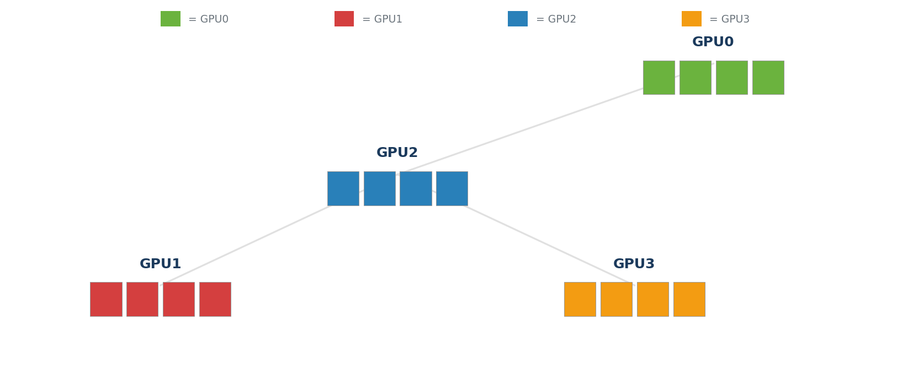
11
Tree AllReduce — How NCCL Behaves — Multi-Chunk
Initial: each GPU has 4 chunks (own data)
Stripes = sources | Dashed = OUT | Thick = IN | Pipeline: chunks overlap across tree levels
36/59

Slide 10

11
Tree AllReduce — How NCCL Behaves — Multi-Chunk
Step 0: leaves send c0 → GPU2 (reduce)
Stripes = sources | Dashed = OUT | Thick = IN | Pipeline: chunks overlap across tree levels
37/59

Slide 11
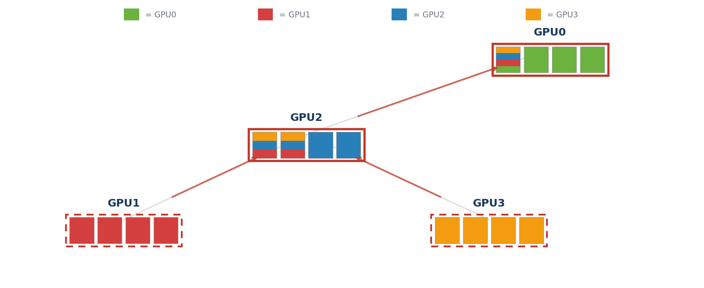
11
Tree AllReduce — How NCCL Behaves — Multi-Chunk
Step 1: leaves c1→GPU2 | GPU2 reduced_c0→GPU0
Stripes = sources | Dashed = OUT | Thick = IN | Pipeline: chunks overlap across tree levels
38/59

Slide 12
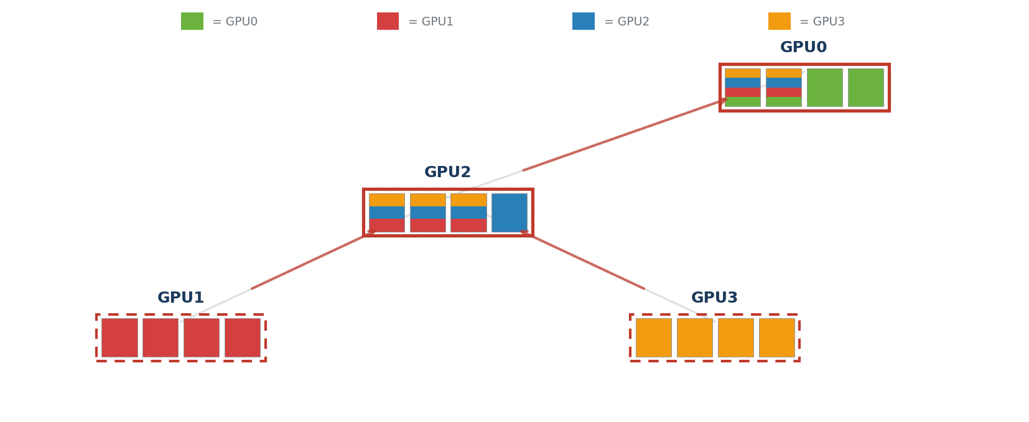
11
Tree AllReduce — How NCCL Behaves — Multi-Chunk
Step 2: leaves c2→GPU2 | GPU2 reduced_c1→GPU0
After (Number of Chunks - 1) steps, all chunks except the last one have been sent to GPU2.
Stripes = sources | Dashed = OUT | Thick = IN | Pipeline: chunks overlap across tree levels
39/59

Slide 13

11
Tree AllReduce — How NCCL Behaves — Multi-Chunk
Step 3: leaves c3→GPU2 | GPU2 reduced_c2→GPU0
Stripes = sources | Dashed = OUT | Thick = IN | Pipeline: chunks overlap across tree levels
40/59

Slide 14
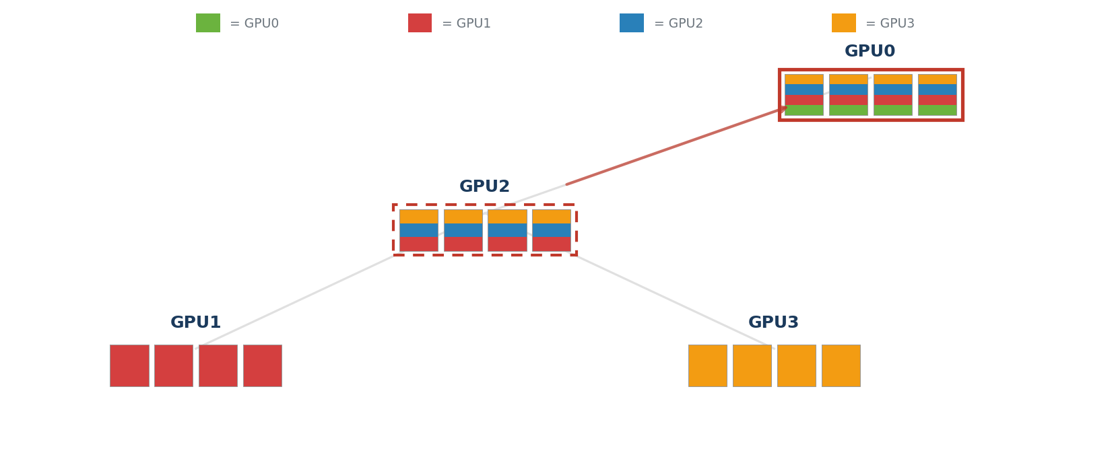
11
Tree AllReduce — How NCCL Behaves — Multi-Chunk
Step 4: GPU2 reduced_c3→GPU0 (Reduce DONE)
The last chunk needs log₂N steps to finish the reduce process.
Stripes = sources | Dashed = OUT | Thick = IN | Pipeline: chunks overlap across tree levels
41/59

Slide 15
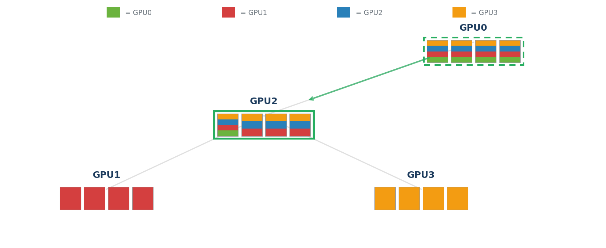
11
Tree AllReduce — How NCCL Behaves — Multi-Chunk
Step 5: GPU0 c0→GPU2 (Broadcast starts)
Stripes = sources | Dashed = OUT | Thick = IN | Pipeline: chunks overlap across tree levels
42/59

Slide 16
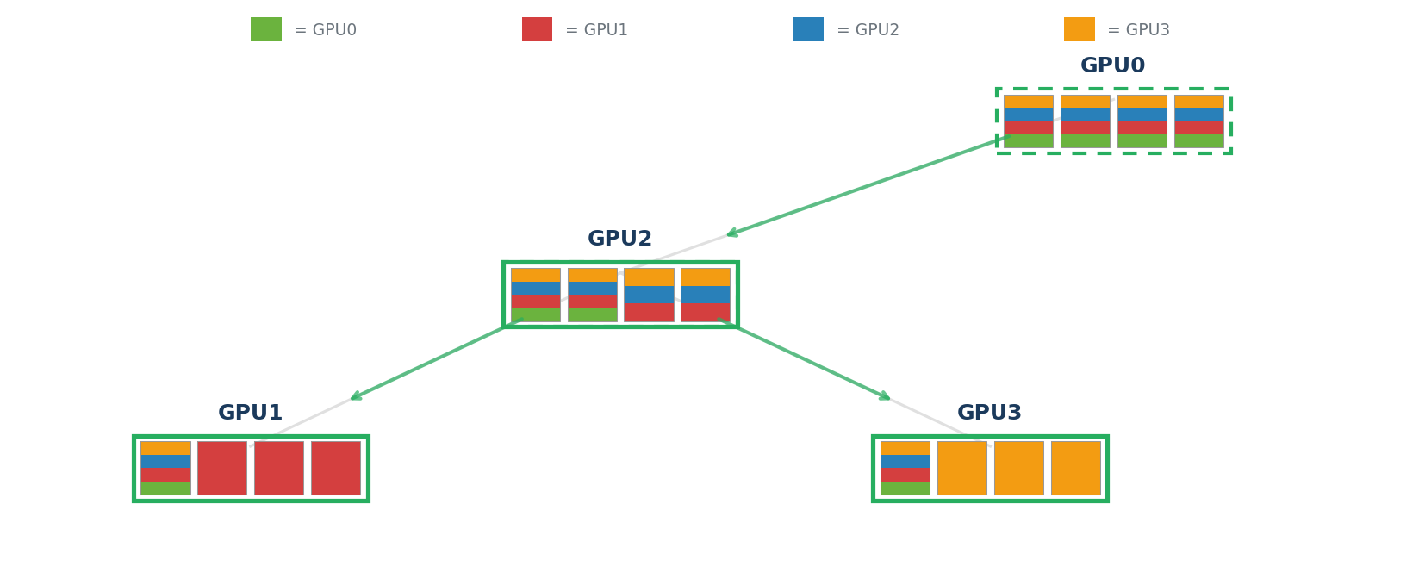
11
Tree AllReduce — How NCCL Behaves — Multi-Chunk
Step 6: GPU0 c1→GPU2 | GPU2 c0→leaves
Stripes = sources | Dashed = OUT | Thick = IN | Pipeline: chunks overlap across tree levels
43/59

Slide 17
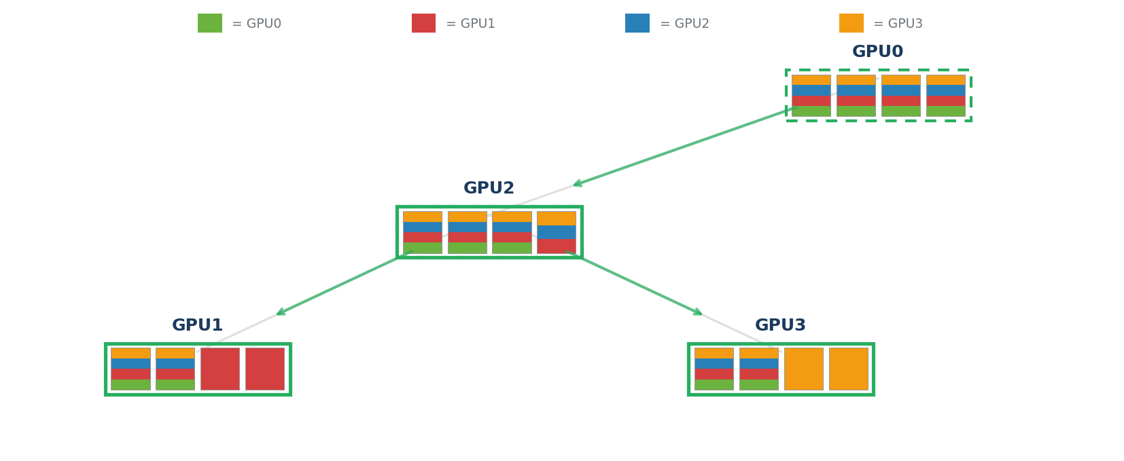
11
Tree AllReduce — How NCCL Behaves — Multi-Chunk
Step 7: GPU0 c2→GPU2 | GPU2 c1→leaves
After (Number of Chunks - 1) steps, all reduced chunks except the last one have been sent to GPU2.
Stripes = sources | Dashed = OUT | Thick = IN | Pipeline: chunks overlap across tree levels
44/59

Slide 18
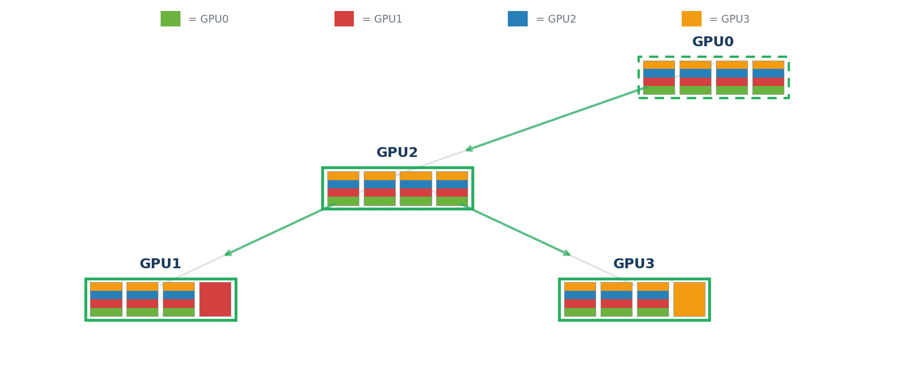
11
Tree AllReduce — How NCCL Behaves — Multi-Chunk
Step 8: GPU0 c3→GPU2 | GPU2 c2→leaves
Stripes = sources | Dashed = OUT | Thick = IN | Pipeline: chunks overlap across tree levels
45/59

Slide 19
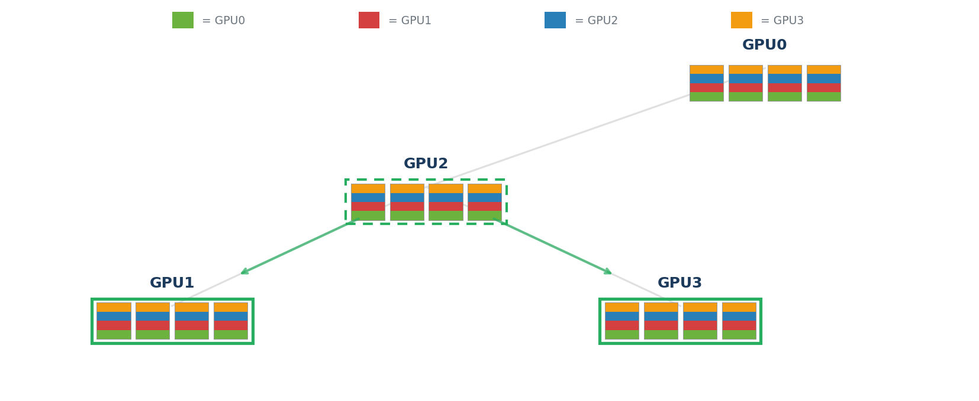
11
Tree AllReduce — How NCCL Behaves — Multi-Chunk
Step 9: GPU2 c3→leaves (ALL DONE)
The last chunk needs log₂N steps to finish the broadcast process.
Stripes = sources | Dashed = OUT | Thick = IN | Pipeline: chunks overlap across tree levels
46/59

Slide 20
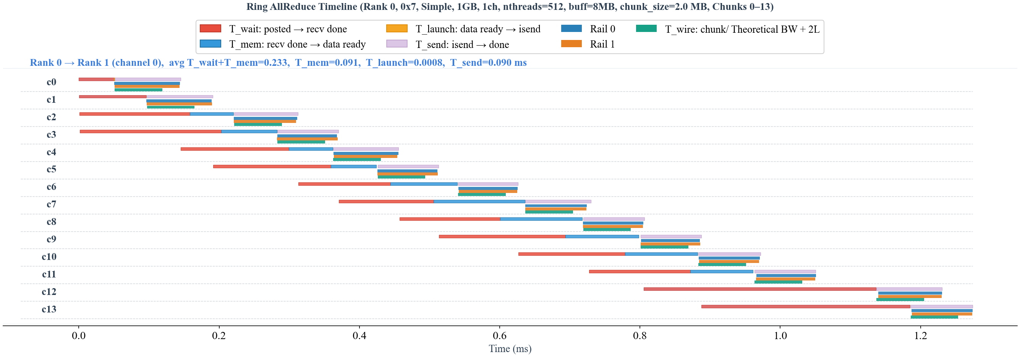
o_net = T_send – T_wire
o_round = the gap between two consecutive rounds.
Here, each round has 4 × (number of GPUs − 1) = 12 chunks.
o_mem = T_mem

